Slide 1

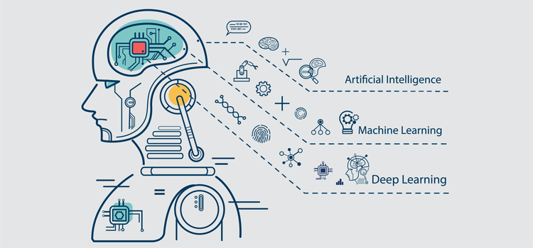

Slide 2



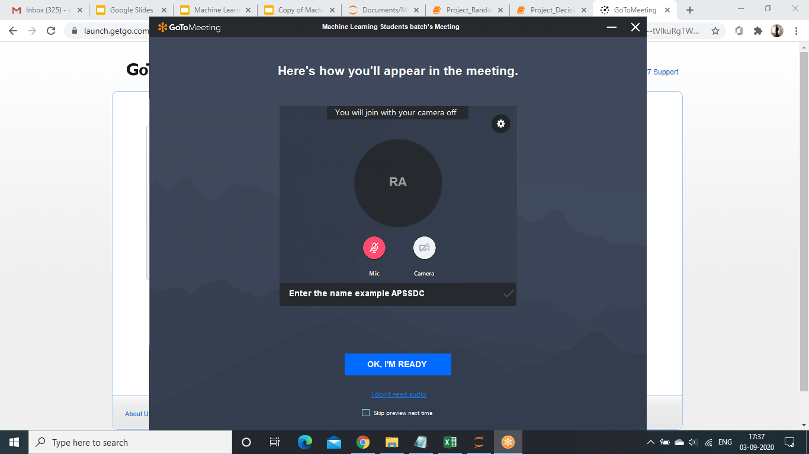
Roll Number - Name - College Name

Slide 3
Github Link: http://bit.ly/apssdc-ml-eb6
Attendance

Slide 4
Pre Requirements
Before Going to Machine Learning We need Some Pre Requirements
Numpy
Pandas
Matplotlib
Seaborn

Slide 5
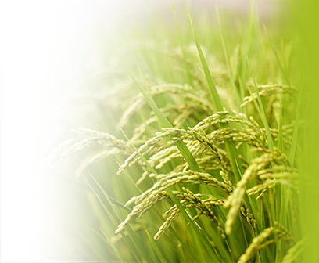
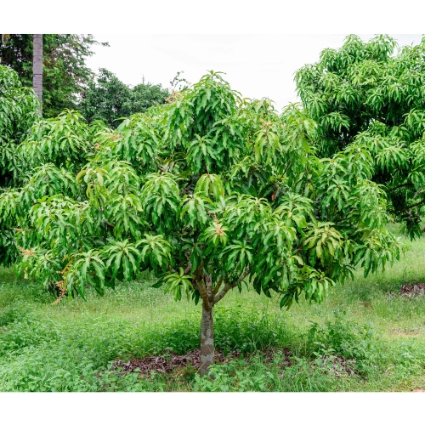

Slide 6


Slide 7
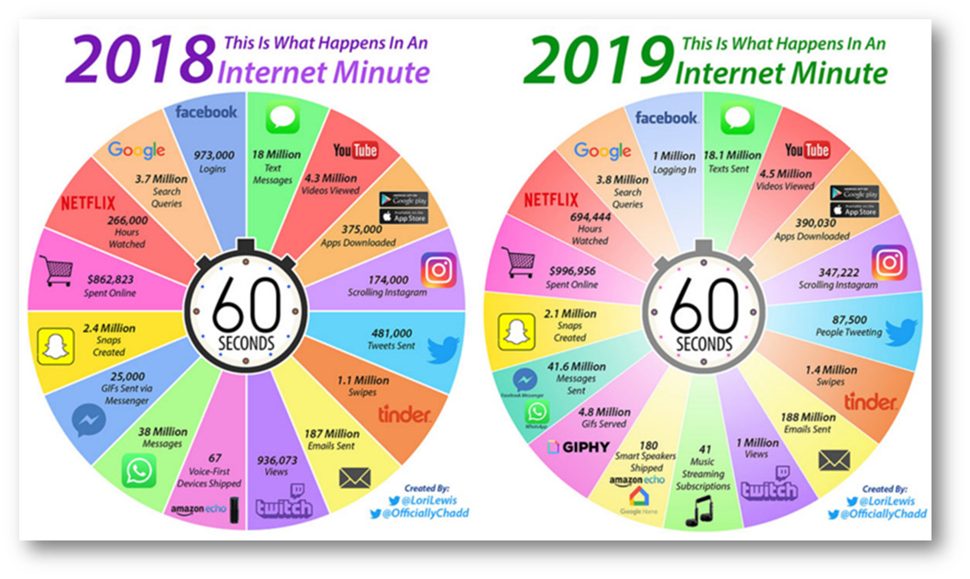

Slide 8
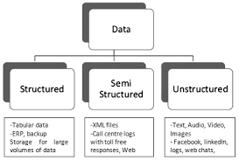
Types of Data
Structure data → data from database
unstructured data → audio,videos,Rdf
Semi structure → json,xml

Slide 9
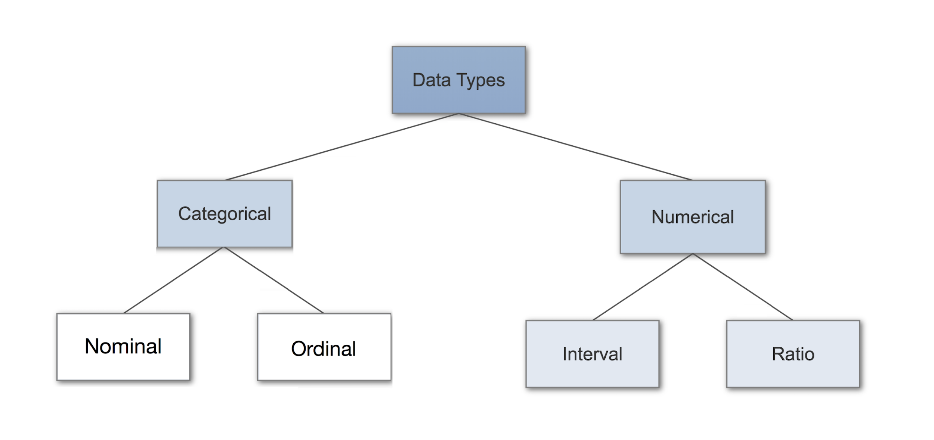

Slide 10
Structured Data is get organized by the means of Relational Database.
Semi Structured Data is partially organized by the means of XML/RDF.
Unstructured Data data is based on simple character and binary data.
Categorical variables can be further categorized as either nominal, ordinal or dichotomous. Nominal variables are variables that have two or more categories, but which do not have an intrinsic order.
Ordinal variables include: socio economic status (“low income”,”middle income”,”high income”), education level (“high school”,”BS”,”MS”,”PhD”), income level (“less than 50K”, “50K-100K”, “over 100K”), satisfaction rating (“extremely dislike”, “dislike”, “neutral”, “like”, “extremely like”)

Slide 11
Interval data is like ordinal except we can say the intervals between each value are equally split.
Time,Age,Temperature
Ratio data is interval data with a natural zero point.
Ratio data has a defined zero point. Income, height, weight, annual sales, market share, product defect rates, time to repurchase, unemployment rate, and crime rate are examples of ratio data

Slide 12
Why Machine Learning
Students Answers

Slide 13
Why Machine Learning
High Dimensional
Evolution in Technology
Reduces Overload
Saves Time and Money

Slide 14
Machine Learning
Machine want to learn Something

Slide 15

Machine Learning
Machine learning is an application of artificial intelligence (AI) that provides systems the ability to automatically learn and improve from experience without being explicitly programmed. Machine learning focuses on the development of computer programs that can access data and use it learn for themselves.

Slide 16
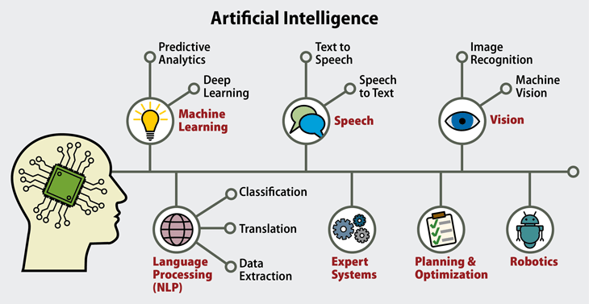

Slide 17
Applications of ML
Machine learning is a buzzword for today's technology, and it is growing very rapidly day by day. We are using machine learning in our daily life.
Examples : Google Map , Google Assistant , Alexa
Image Recognition
Speech Recognition
Traffic Prediction
Real time Location
Average time has taken
Product Recommendation

Slide 18
Below are some more Applications
5. Email Spam Detection
6. Online Fraud Detection
7. Self Driving Car
8.Stock Market Tracking
9. Medical Diagnosis
10. Automatic Language Translation

Slide 19
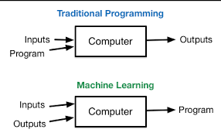

Slide 20
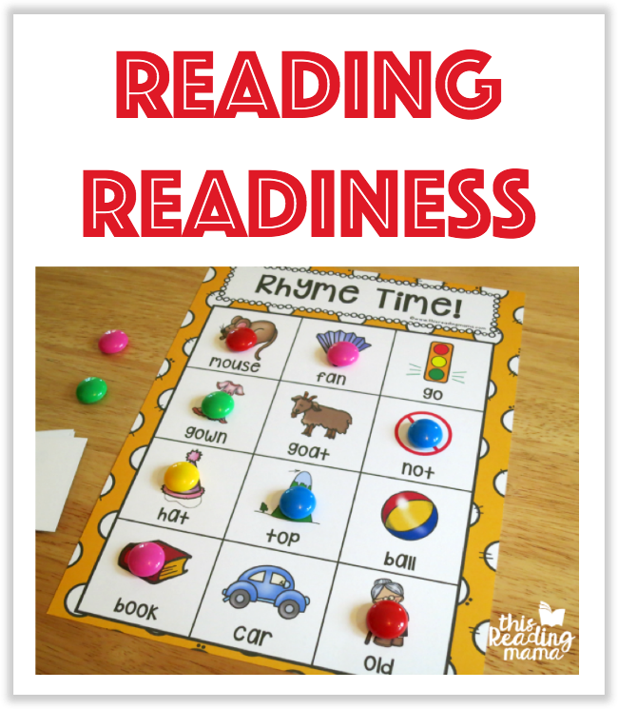
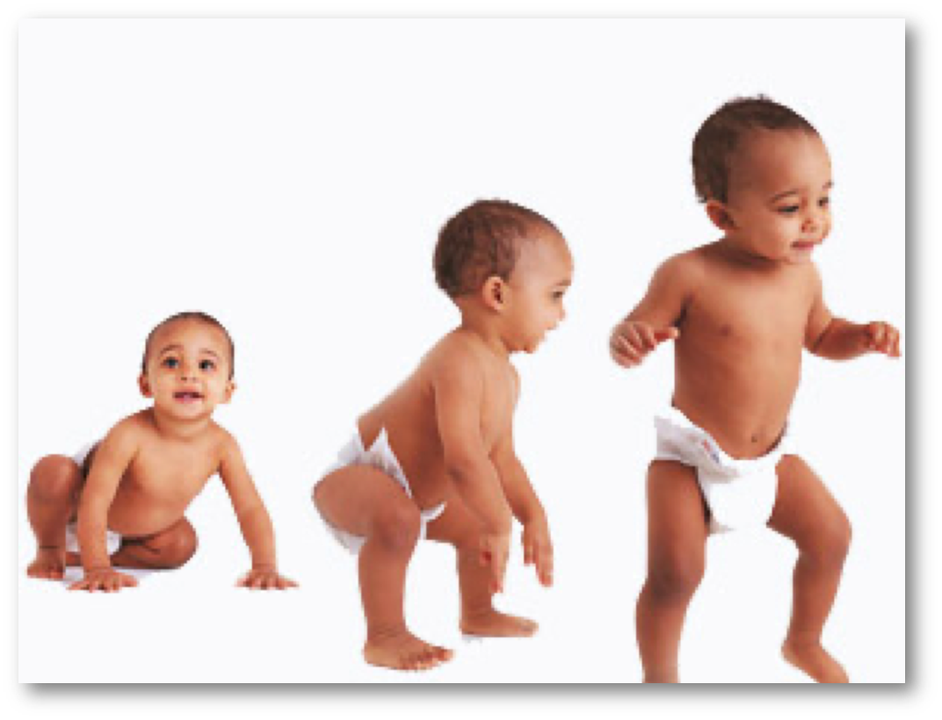

Slide 21
Types of Machine Learning
These are three types of machine learning:
supervised learning
Regression
Classification
unsupervised learning
Clustering
Dimensionality reduction
reinforcement learning.

Slide 22
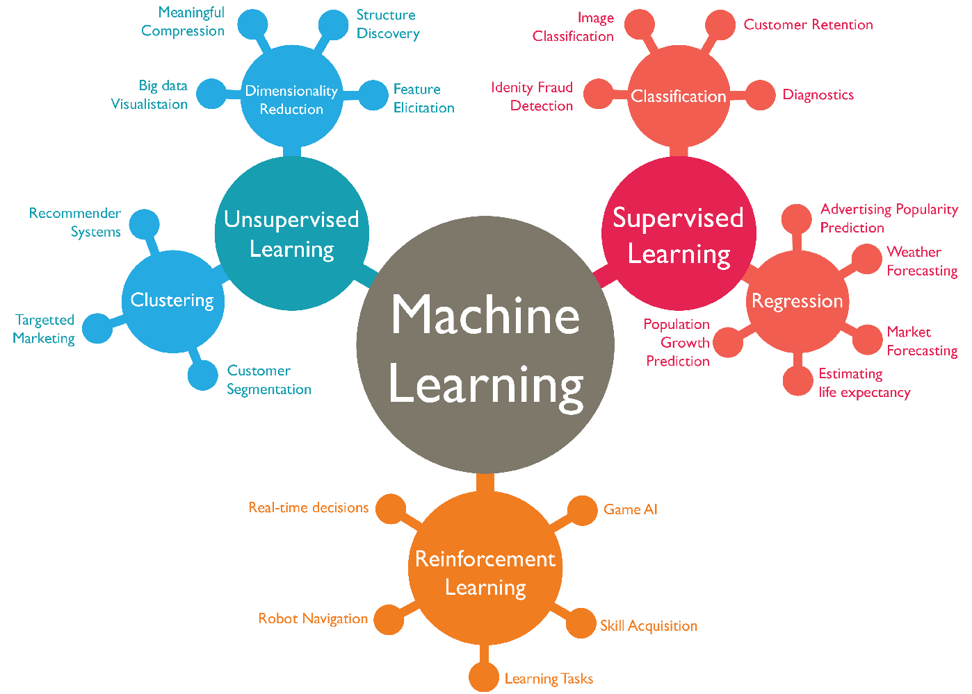

Slide 23
Supervised Machine Learning
Supervised learning is the types of machine learning in which machines are trained using well "labelled" training data
Supervised learning is a process of providing input data as well as correct output data to the machine learning model. The aim of a supervised learning algorithm is to find a mapping function to map the input variable(x) with the output variable(y).
Applications:
Risk Assessment
Image classification
Fraud Detection, spam filtering

Slide 24

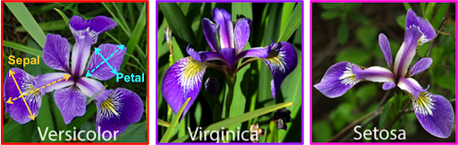
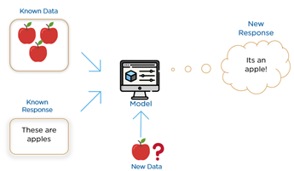
Applications of Supervised ML

Slide 25
Types of Supervised ML
Two types of Supervised Machine Learning :
Regression
Classification
Regression: Regression algorithms are used if there is a relationship between the input variable and the output variable. It is used for the prediction of continuous variables
Classification algorithms are used when the output variable is categorical, which means there are two classes such as Yes-No, Male-Female, True-false, etc.

Slide 26
Different Algorithms SML
There are different Algorithms or models in Supervised Machine Learning
Linear Regression
Non Linear Regression
KNN Algorithm
Logistic Regression
Support Vector Machine
Decision Tree Regressor
Decision Tree Classifier
Random Forest

Slide 27
Unsupervised Machine Learning
unsupervised learning is a machine learning technique in which models are not supervised using training dataset. Instead, models itself find the hidden patterns and insights from the given data.
Two types of Unsupervised Machine Learning:
Clustering
Association

Slide 28
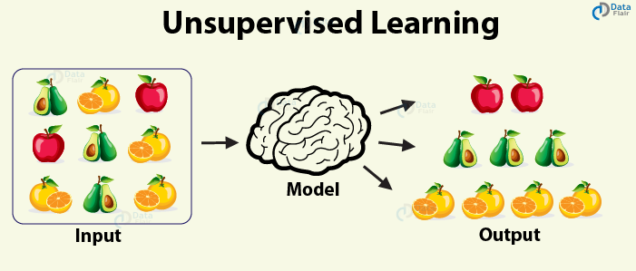

Slide 29
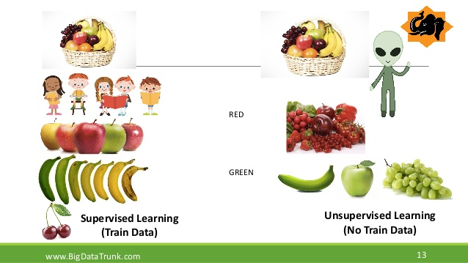

Slide 30

ML Process Steps

Slide 31
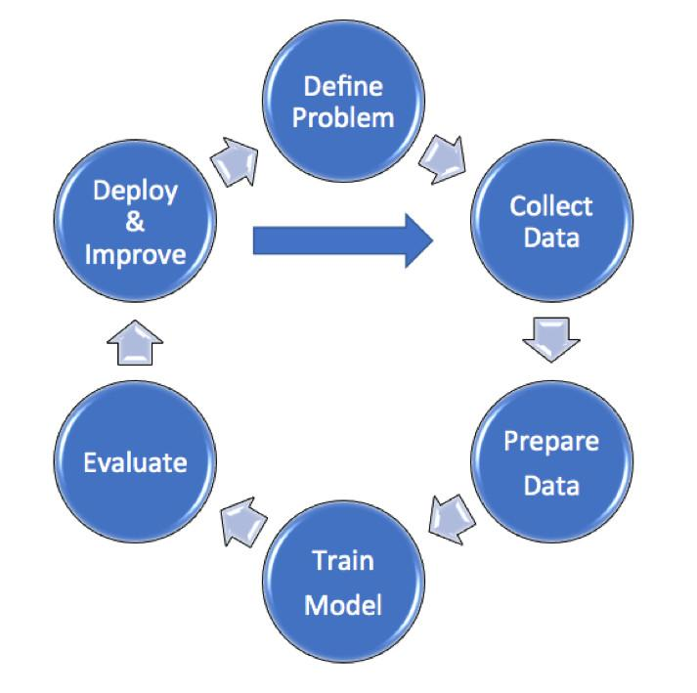

Slide 32
Overfitting and Underfitting
Overfitting Vs Underfitting:
Ex: One student learn only addition Operation and another student learn all the textbook then if you conduct exam on mathematical operations

Slide 33
BIAS: It is the difference between the Average Predictions of a model and the correct values which we are trying to Predict.
Variance: It is the Variability of model Prediction for a given data point or a value that tells us the Spread of a data.
High Bias is Underfitting
High Variance is Overfitting
Regularization: These are techniques used to reduce the error by fitting a function appropriately on the given training set avoid overfitting.

Slide 34
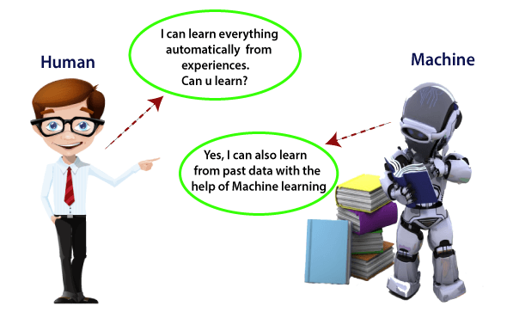

Slide 35
Examples
All are previously Guess by one experience persons
Power Required Classify the data into categories
carona or not
Shirt size prediction

Slide 36
HOW TO GET DATASETS
Research and get the data
Get already exist data from different sources
Kaggle
Packages (Sklearn)

Slide 37

Ranganayakulu APSSDC

